Slide 1
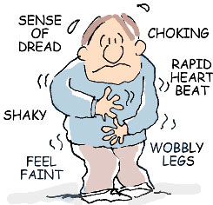
Panic Disorder
Symptoms
  Recurrent, sudden onset of intense terror that often occurs without warning
  NO SPECIFIC CAUSE
  Panic Attacks are persistent
Etiology (Causes)
  Biological Factors
    Genetic Predisposition
    Norepinephrine, GABA, and Serotonin
    Hormone regulation in response to stress
  Sociocultural Factors
    Women > Men

Slide 2
Panic Disorder vs. GAD
Generalized Anxiety Disorder (GAD) = long-term anxiety
Panic Disorder = short, intense bursts of anxiety

Slide 3
What Causes Panic Disorder?
1) Conditioning theory: Neutral stimuli are paired with a panic attack, then anxiety about those stimuli in future situations induces panic (Wolpe & Rowan, 1988)
2) Substance use: Drug/alcohol abuse common precursors of PD. ~40% of people with PD previously had problems with addiction to drugs or alcohol (Katerndahl & Realini, 1999)
3) Biological causes: Lactates (a supplemental source of energy) are elevated for individuals with panic disorder (Maddock et al., 2009)

Slide 4
Anxiety Disorders
Phobias: Specific fears of a certain target
Phobia | Target
Arachnophobia | Spiders
Chromophobia | Colors
Social Phobia | Social interaction
Claustrophobia | Small spaces
Agoraphobia | Crowds, other spaces in which escape is difficult
Acrophobia | Heights

Slide 5
Phobias
Phobias vs. Fear
To classify as a phobia, an individual must a) almost always respond to the target with fear, b) feel that the persistent fear is excessive or unreasonable

Slide 6

Agoraphobia
Phobia related to being in a public place where escape is difficult
  Occurs both with and without panic attacks
  Panic attacks occur randomly, therefore they are unpredictable
Individuals often withdraw from society
  Avoid public places
  Avoid travel
200,000 new cases in the US/year (fairly common)

Slide 7
Specific Phobia
Symptoms
  Irrational, overwhelming fear of a particular object or situation that is excessive and unreasonable
  Exposure to stimulus immediately provokes response
Etiology
  Biological Factors
    Genetic predisposition
  Psychological Factors
    Learned from previous experience, typically before the mid 20’s

Slide 8
Social Anxiety Disorder
Symptoms
  Intense fear of being humiliated and/or embarrassed in social situations
Etiology
  Biological Factors
    Genetic disposition
    Neural circuitry (amygdala shows heightened reactivity)
    High levels of serotonin
  Psychological Factors
    Over-protective/Rejecting parenting
    Negative learned social experiences

Slide 9
Obsessive-Compulsive Disorder (OCD)
Symptoms
  Persistent anxiety-provoking thoughts and/or urges
  Obsessions – Recurrent thoughts
  Compulsions – Recurrent actions
Etiology
  Biological Factors
    Genetic predispositions
    Neurotransmitters
  Psychological Factors
    Avoidance learning

Slide 10
Obsessive-Compulsive Disorder (OCD)
Obsessions are recurrent and cause anxiety.
To qualify for OCD:
  A person must realize that obsessions are irrational or a product of their mind, but that they cannot be controlled (Abramowitz, Taylor, & McKay, 2009)

Slide 11
Obsessive-Compulsive Disorder (OCD)
Compulsions are rituals designed to alleviate the anxiety of the obsession
Example: obsessive fears about the future may cause people to compulsively buy things, acquire free items, or hang on to old items (hoarding; Frost & Steketee, 2011)

Slide 12
Causes of OCD
1) Biological: Reduced serotonin and dopamine
2) Psychological: OCD is associated with selective learning of negative outcomes

Slide 13
Post-Traumatic Stress Disorder (PTSD)
Symptoms
  Exposure to previous traumatic experience, oppressive situation, natural or unnatural disaster
  Active reliving of the trauma (flashbacks)
  Types
    Acute: 3 months or less
    Chronic: Greater than 3 months
    Delayed onset: Symptoms appear 6 months after the event
  Affects 10-20% of military veterans
Etiology
  Biological Factors
    Genetic predisposition
  Development is primarily psychological

Slide 14
Post-Traumatic Stress Disorder (PTSD)
Not everyone who experiences a traumatic event develops PTSD: estimates are usually below 25%
One factor that increases the risk of PTSD is the nature of trauma
  Rape, sexual abuse, and personal assault all showing higher rates than serious accidents (Hapke et al., 2006)

Slide 15
Mood-Related Disorders
Disturbance of mood that affects one’s emotional state
Symptoms may include:
  Cognitive, behavioral, or physical symptoms
  Interpersonal difficulties
Comorbid with anxiety disorders

Slide 16
Major Depressive Disorder
Symptoms
  Significant depressive episode that lasts for at least 2 weeks
  Daily functioning is impaired
  Fatigue, sense of worthlessness, reduced interest, sleep disturbance, appetite suppression
Not in response to negative life events (e.g., bereavement)

Slide 17
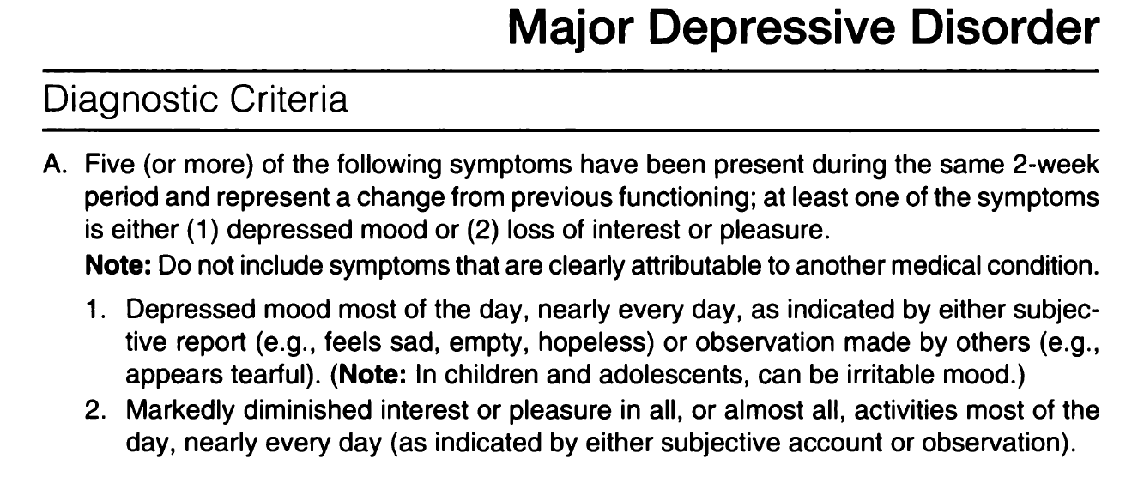
Major Depressive Disorder:
DSM-V Diagnostic Criteria

Slide 18
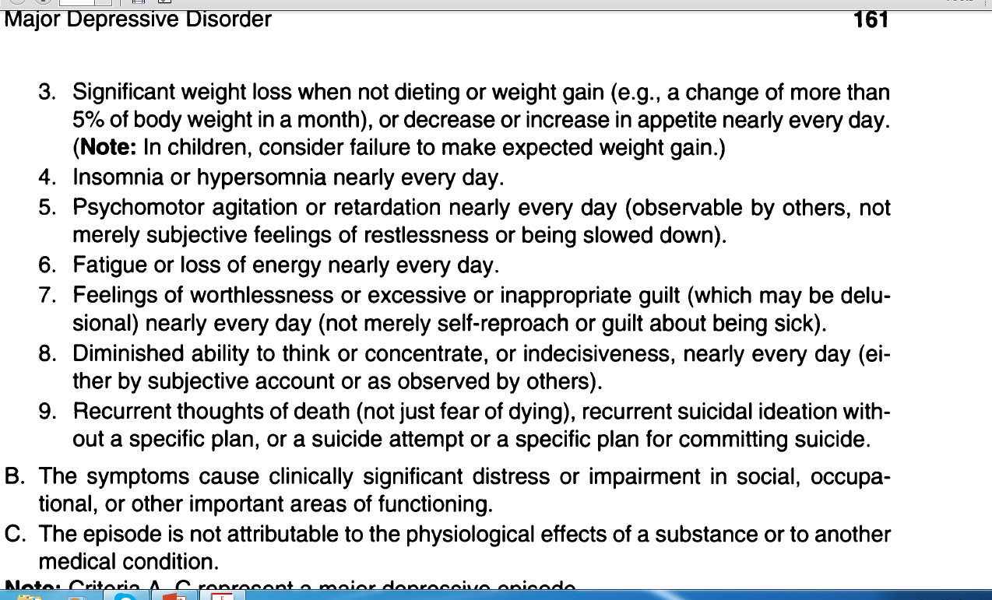
Major Depressive Disorder:
DSM-V Diagnostic Criteria

Slide 19
Major Depressive Disorder
Etiology
  Biological Factors
    Genetic Disposition
    Underactive prefrontal cortex
    Neurotransmitters (Serotonin, MAO)
  Psychological Factors
    Learned helplessness
    Ruminating on negativity
    Pessimism
  Sociocultural Factors
    Poverty
    Low SES
    Women > Men

Slide 20
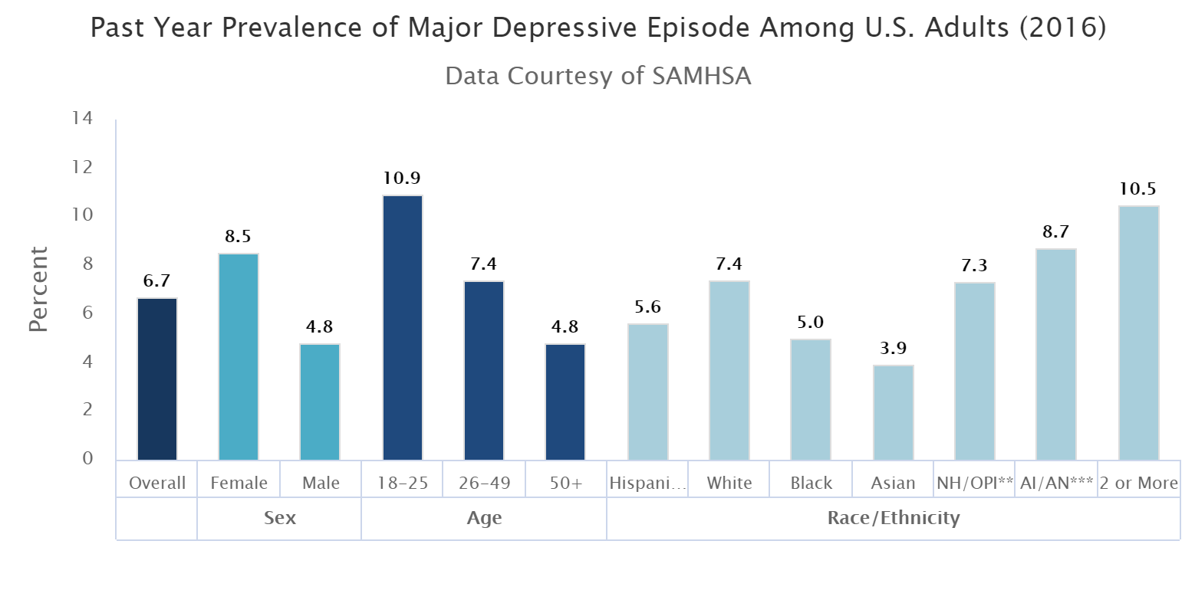
Depression

